Slide 1

Understanding the
2015 Smarter Balanced Assessment Results
Assessment Services

Slide 2
Understanding Smarter Balanced Assessment Results
Principals of Scoring
Key Reminders While Reviewing Results
Scores Students Will Receive
Resources for More Information

Slide 3
Principles of Scoring
Computer Adaptive Testing
Pattern Scoring

Slide 4


A Computer Adaptive Test (CAT) is Based on:
  Large item bank - covering all areas assessed and varying levels of difficulty
  Recommended blueprint - focuses the selection of questions from the test bank to appropriate content so the structure of the test is similar for every student

Slide 5

A Computer Adaptive Test (CAT) is Based on (Continued):
  Programming language (or algorithm) - a step-by-step approach that tells the CAT what to do next based on students’ answers
  Algorithm rules – set of rules to ensure each student’s test contains the proper types of questions and content covered
        Balance – enough of the concept
        Question type – selected response, constructed response
        Reading length – short, medium, long
        Difficulty – appropriate for grade level

Slide 6
How Does a CAT Work?
Example: A Student of Average Ability
Expanded
Very High
Ability
High
Med-High
Medium
PATTERN
Med-Low
Low
Expanded
Very Low
Test Questions
1
2
3
4
5
6
7
8
9
10
Answers (R/W)
R R W R W W W W R R

Slide 7
Scoring the CAT
  Final scale scores are based on item PATTERN SCORING:
As a student progresses through the test, his or her pattern of responses is tracked and revised estimates of the student’s performance are calculated
Scores from the CAT portion of the test are based on the difficulty of the items that were right or wrong, NOT on the total number of correct answers
The test question bank for a particular grade level are designed to include an enhanced pool of test questions that are more or less difficult, but still match the test blueprint for that grade

Slide 8
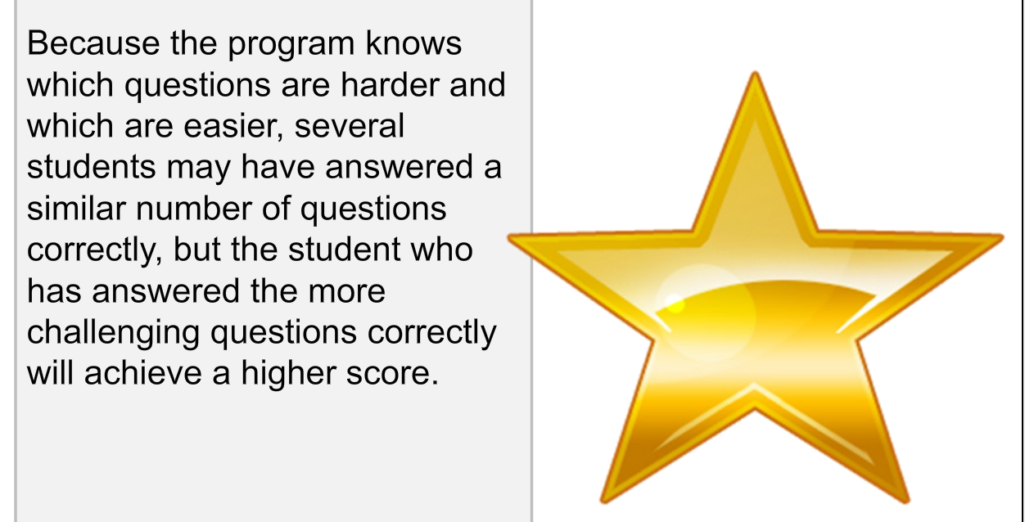
Key Principle of Scoring

Slide 9
SCORES STUDENTS WILL RECIEVE
Reporting Scale
Overall Achievement Levels
Claim Level Performance

Slide 10
Reporting Scale
Computer-scored items are merged with hand-scored items
After estimating the student’s overall performance, it is mapped onto the reporting scale
Scores are on a vertical scale
  Expressed on a single continuum for a content area
  Measures student growth over time across grade levels
For each grade level and content area, there is a separate scale score range

Slide 11

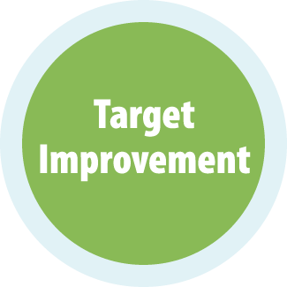
Overall Achievement Levels
    Achievement level classifications are based on overall scores for English language arts and mathematics
Exceeded the Standard
Met the Standard
Nearly Met the Standard
Has Not Met the Standard
Notes:
Students will receive one of four score levels.
Students scoring in the two top levels are on a path to be college and career ready at high school graduation.
Students scoring below the “Met the Standard” level will need further development to get on path.
Elementary & Jr. High: We are in a transition year – More students are likely to need further development to meet the new standards . But its ok, as students spend additional time in class rooms employing the new curriculum and teaching, results will improve.
High School: We are in a transition periods – Results may show more students are likely to need further development to meet the new standards. But it’s ok – students still have another year to continue to progress. They are now on a focused path to gaining these skills.
Public colleges and universities in several states have decided to use the results of the Grade 11 ___________exams to help determine whether admitted students are ready to proceed directly to entry-level, credit-bearing courses and can skip the placement tests that are typically administered. In all of these cases colleges will continue to use their existing admissions criteria.
<insert state specific policy>

Slide 12
Smarter Balanced Scale Score Ranges for ELA/Literacy
Grade | Level 1 (Not Met) | Level 2 (Nearly Met) | Level 3 (Met Standard) | Level 4 (Exceeded)
3 | 2114–2366 | 2367–2431 | 2432–2489 | 2490–2623
4 | 2131–2415 | 2416–2472 | 2473–2532 | 2533–2663
5 | 2201–2441 | 2442–2501 | 2502–2581 | 2582–2701
6 | 2210–2456 | 2457–2530 | 2531–2617 | 2618–2724
7 | 2258–2478 | 2479–2551 | 2552–2648 | 2649–2745
8 | 2288–2486 | 2487–2566 | 2567–2667 | 2668–2769
11 | 2299–2492 | 2493–2582 | 2583–2681 | 2682–2795
Notes:
This table shows the scale score ranges for each achievement level by grade for English language arts.

Slide 13
Smarter Balanced Scale Score Ranges for Mathematics
Grade | Level 1 (Not Met) | Level 2 (Nearly Met) | Level 3 (Met Standard) | Level 4 (Exceeded)
3 | 2189–2380 | 2381–2435 | 2436–2500 | 2501–2621
4 | 2204–2410 | 2411–2484 | 2485–2548 | 2549–2659
5 | 2219–2454 | 2455–2527 | 2528–2578 | 2579–2700
6 | 2235–2472 | 2473–2551 | 2552–2609 | 2610–2748
7 | 2250–2483 | 2484–2566 | 2567–2634 | 2635–2778
8 | 2265–2503 | 2504–2585 | 2586–2652 | 2653–2802
11 | 2280–2542 | 2543–2627 | 2628–2717 | 2718–2862
Notes:
This table shows the scale score ranges for each achievement level by grade for Mathematics.

Slide 14
Claim Results: A Deeper Look
Achievement levels for claims are very similar to subscores; they provide supplemental information regarding a student’s strengths or weaknesses
Only three achievement levels for claims were developed since there are fewer items within each claim
A student must complete all items within a claim to receive an estimate of his or performance on a claim
Below
At/Near
Above

Slide 15
Achievement Levels for Claims
English Language Arts
Reading
Writing
Speaking & Listening
Research/Inquiry
Above Standard
Above Standard
At/Near Standard
At/Near Standard
Mathematics
Concepts & Procedures
Problem Solving & Data Analysis
Communicating Reasoning
Below Standard
Below Standard

Slide 16
Understanding Your Child’s Score
https://www.youtube.com/watch?v=FQi4qlOCrmk&feature=youtu.be

Slide 17
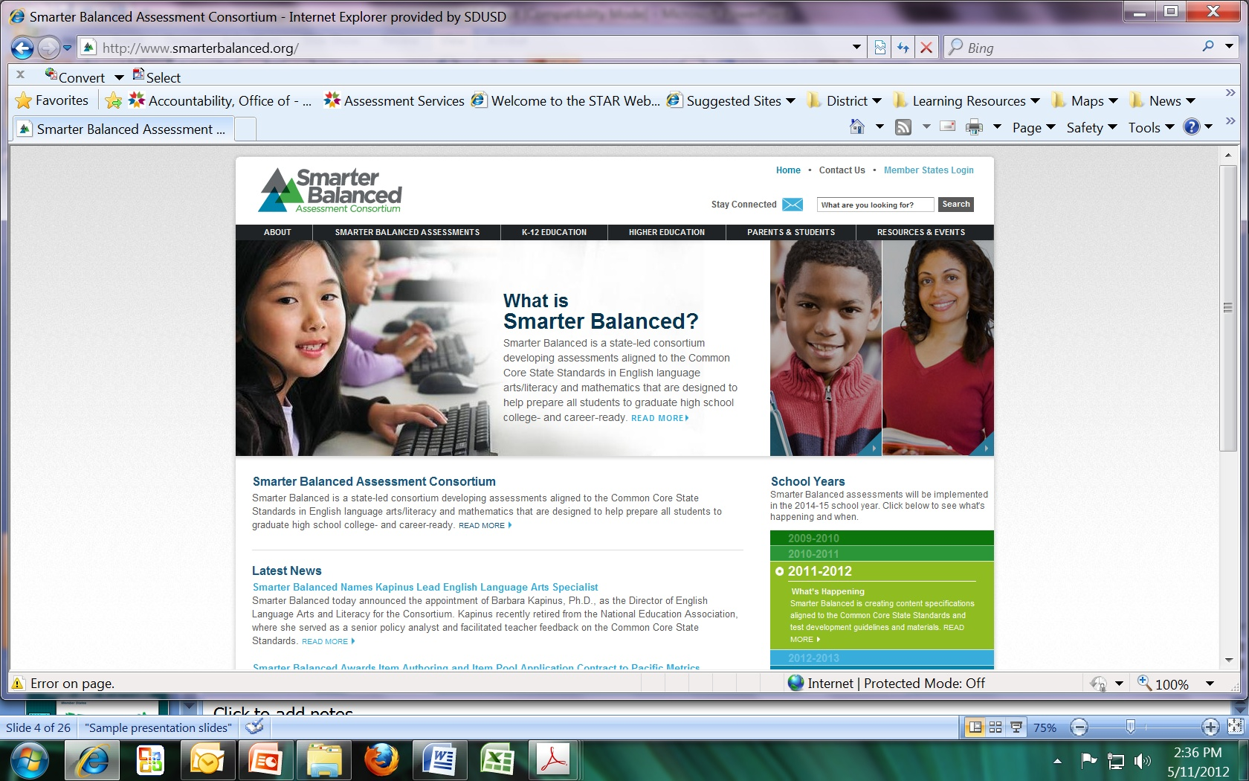
Reminders While Reviewing Results

Slide 18
Key Reminder #1:
A System to Improve Learning
Summative
Smarter
Balanced:
Teachers and schools have information and tools to improve teaching and learning
CCSS:
Standards set
expectations on a path to college and career readiness
GOAL:
All students graduate college
and career ready
Digital Library
Interims
Notes:
First, the goal of Common Core State Standards and the Smarter Balanced assessment system is that all students graduate from our schools ready for college and career. This represents a comprehensive approach for measuring students’ performance in demonstrating critical thinking skills, essential to success in post-secondary education and the workforce.

Slide 19
Key Reminder #2:
New Test, New Baseline
This year will establish a baseline for the progress we expect students to make over time toward college and career readiness
Many if not most students will need to make significant progress to reach the at or above standard level
Real progress takes time and effort
These results will provide us an opportunity to focus on the needs of students and teachers
Notes:
The next reminder while you review the results, is that this is a new test and a new baseline. This year will establish a baseline for progress we expect students to make over time toward college and career readiness. Many students will need to make significant progress to reach the at or above standard level. We all know that real progress takes time and effort and doesn’t happen over night. The Smarter Balanced results will provide us an opportunity, a starting point to focus on the needs of students and teachers.

Slide 20
Out with the Old – In with the New
Challenging standards to ensure students gain the skills required for college and the workforce of tomorrow
New Standards
New Teaching
New methods of teaching that engage students to develop the critical thinking and problem solving skills they will need
New Learning
New Test
Old assessments have been replaced with new tests that measure student progress and provide information for targeting improvement
Notes:
Out with the old and in with the new.
We have new challenging standards to ensure our students gain the skills necessary for college and the workforce of tomorrow.
New methods of teaching are required to engage students in activities that require critical thinking and problem solving.
The old assessments have been replaced with Smarter Balanced. These new tests measure student progress and provide information for targeting improvement.

Slide 21
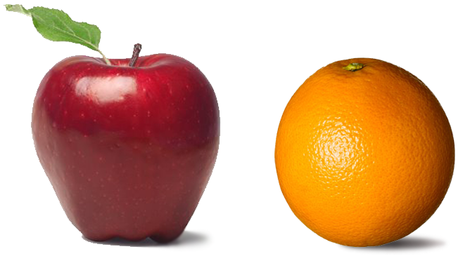

Key Reminder #3:
Can’t Compare Apples to Oranges
Key Reminder #3:
Can’t Compare Apples to Sailboats
Like apples and sailboats, the new tests are too different to compare the old scores and new
Notes:
When reviewing the Smarter Balanced assessment results, you might hear people say that you can’t compare apples to oranges.
We would like to revise the message and say you can’t compare apples to sailboats. Like apples and sailboats, the new tests are too different to compare the old scores and new.

Slide 22
Key Reminder #3:
Can’t Compare Apples to Sailboats
 | Smarter Balanced | STAR Assessments
Different Standards | Aligned to CCSS; bar has been raised with high expectations | Aligned to old California standards
Different Item Types | Contains selected response, constructed response, technology enhanced, and performance tasks | Limited to selected response (multiple choice)
Different Format | Test is adaptive which customizes the test for the individual student | Test is fixed form
Different Method of Delivery | Test is taken on the computer via the secure browser | Test is taken on paper with a pencil
Different Levels of Cognitive Rigor | Assesses DOK 1-4 and primarily levels 2 & 3 | Assesses DOK 1 & 2
Notes:
Smarter Balanced assessments are aligned to the new standards; the bar has been raised with high expectations.
The new tests contain selected response, constructed response, technology enhanced, and performance tasks while the old assessments were primarily multiple choice.
The Smarter Balanced assessment is adaptive and customized for the individual student while the old tests were fixed form where everyone took the same test.
Smarter Balanced is taken on the computer while the old STAR tests were paper/pencil.
Finally, because of the various item types, Smarter Balanced assessments are able to assess the different levels of cognitive rigor. They assess Depth of Knowledge levels one, two, three and four with most items assessing levels two and three. The old STAR tests primarily assessed Depth of Knowledge one and two.

Slide 23
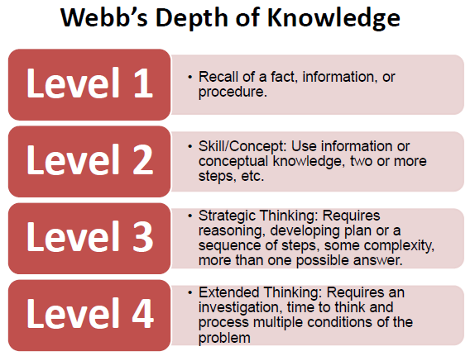
Key Reminder #3: Apples to Sailboats
 | Smarter Balanced | STAR Assessments
Different Levels of Cognitive Rigor | Assesses DOK 1-4 and primarily levels 2 & 3 | Assesses DOK 1 & 2
Notes:
Depth of Knowledge, or DOK level 1 requires students to memorize and recall facts and information.
DOK level 2 requires conceptual knowledge or the ability to put facts in context.
DOK level 3 requires strategic thinking through the use of reasoning and decision making.
DOK level 4 requires extended thinking to synthesize information or apply to real-world applications.

Slide 24
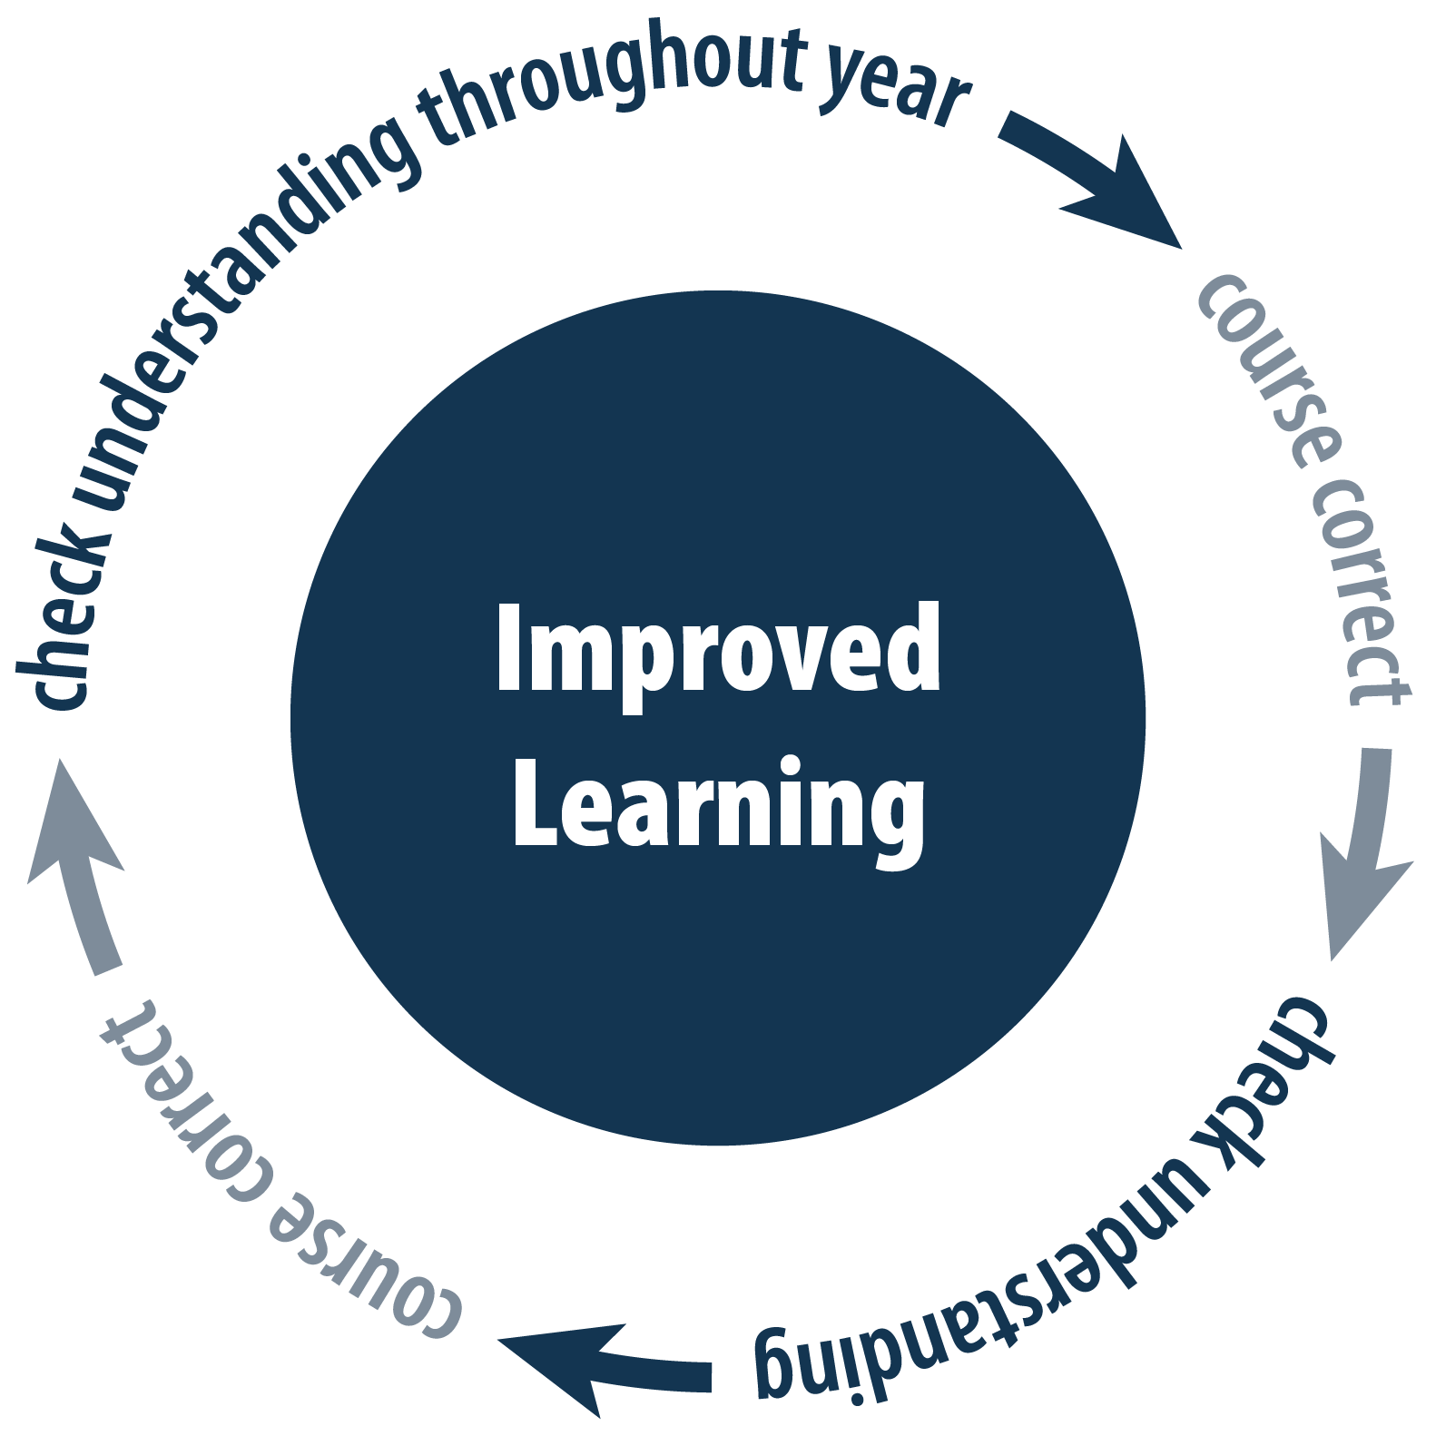

Key Reminder #4:
This is One Snapshot
Smarter Balanced results are just one snapshot of progress
Notes:
The final and most important key point to remember while reviewing the Smarter Balanced results is that this is only one snapshot of progress.

Slide 25
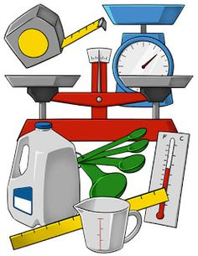
Key Reminder #4:
This is One Snapshot
Using multiple measures provides a better picture of student progress
The annual summative Smarter Balanced assessment is one measure
Other measures of student learning include chapter tests, student writing, classroom projects and assignments, formative assessments, and interim assessments
Notes:
In order to have a complete picture of student progress, we must look at multiple measures. It’s important to look at formative assessments, interim assessments, writing tasks, classroom projects, and other measures that are done throughout the year.

Slide 26

Smarter Balanced Assessment: Student Perspective
https://www.youtube.com/watch?v=Hdfxv6Hmd00&feature=youtu.be

Slide 27

Resources & tools

Slide 28
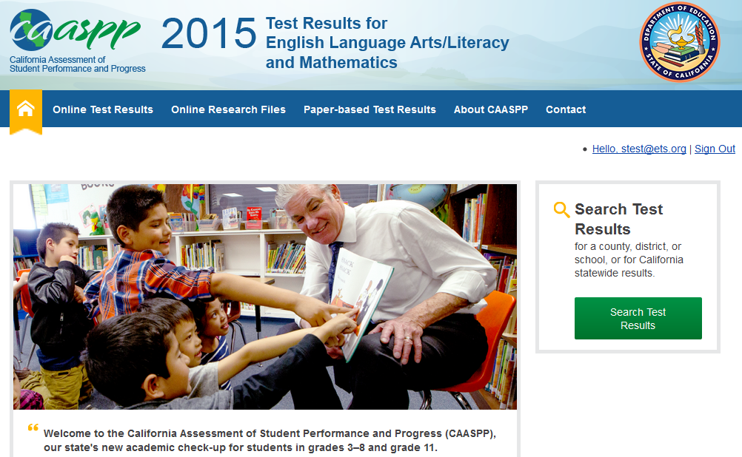
Resources & Tools
CAASPP Results by County, District, and School- http://caaspp.cde.ca.gov/

Slide 29

Resources & Tools
CDE CAASPP Information
http://www.cde.ca.gov/ta/tg/ca/

Slide 30
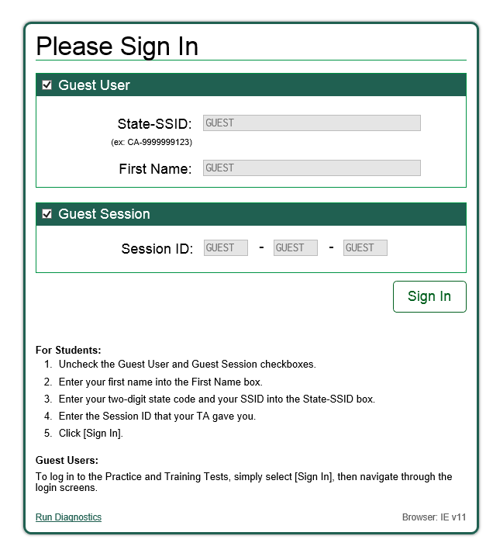
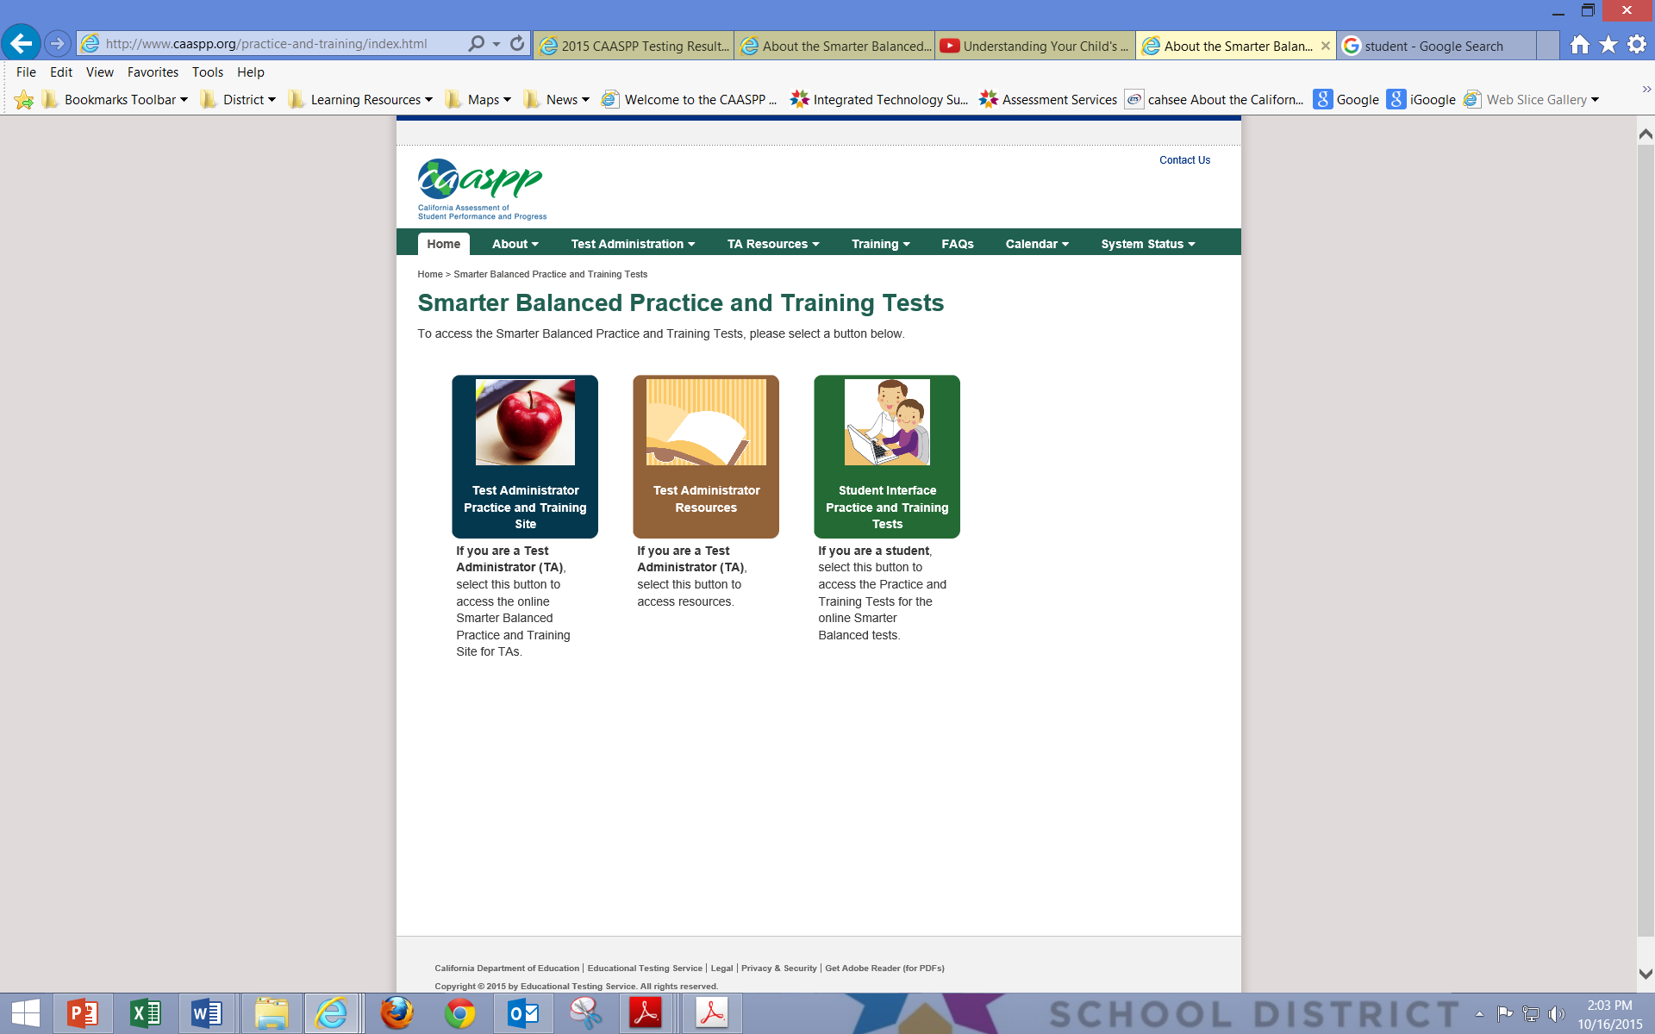
Resources & Tools Continued
Smarter Balanced Practice Tests
http://www.caaspp.org/practice-and-training/index.html

Slide 31
Resources & Tools Continued
CDE Common Core State Standards
http://www.cde.ca.gov/re/cc/ccssresourcesparents.asp
San Diego Unified CAASPP Results
https://www.sandiegounified.org/2015-caaspp-testing-results-information
Smarter Balanced Assessment Consortium
http://www.smarterbalanced.org/parents-students/

Slide 32
Final Thoughts:
It’s a beginning – this year’s score is your baseline
It’s a transition – results may show fewer students have the skills right now, but we are on the right path
It’s the information we need – to help prepare our students for success in college and careers
Notes:
We have a few final thoughts as you look at the Smarter Balanced assessment results.
Remember, this is a beginning, a starting point. This year’s score is a baseline.
We are in transition. Results may show fewer students have the skills right now, but we are on the right path.
Finally, it’s the information we need to help prepare our students for success in college and careers.

